Slide 1
^{BULE HORA UNIVERSITY}
^{COLLAGE OF Informatics}
DEPARTMENT OF Software Engineering
COURSE NAME : Software Architecture and Design
^{COURSE CODE : SWENG-4152}
^{GROUP ASSIGNMENT}
Name ID No
TUMSA GEMECHU ------------------RU0929/12
BARIE WAKJIRA ------------------- ---RU1351/12
ALEMU BEYENE -----------------------RU1684/12
Submitted to: Mr Getahun .F
Submission date: 15/6/2023
BULE HORA ETHIOPIA

Slide 2
^{Introduction}
Tic-Tac-Toe is a simple, two-player game that is traditionally played on a 3x3 grid.
The goal of the game is for players to position their marks (usually X's and O's) so that they make a continuous line of three cells vertically, horizontally, or diagonally.
The player who succeeds in placing three of their marks in a row is the winner.
Design patterns are reusable solutions to common problems in software design, design patterns into your Tic-Tac-Toe game, there are patterns that could be considered.

Slide 3
Tic Tac Toe Game
Tic Tac Toe is a simple, two-player game that is traditionally played on a 3x3 grid.
The goal of the game is for players to position their marks (usually X's and O's) so that they make a continuous line of three cells vertically, horizontally, or diagonally.
The player who succeeds in placing three of their marks in a row is the winner.

Slide 4
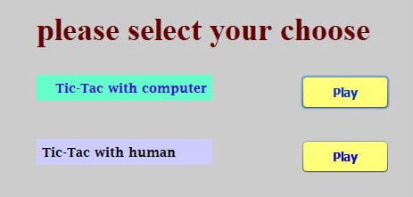
CONT…
It can be played on paper, on a computer, or on a variety of media.
To play the tic tac toe first chose from play with Machine and play with human .

Slide 5
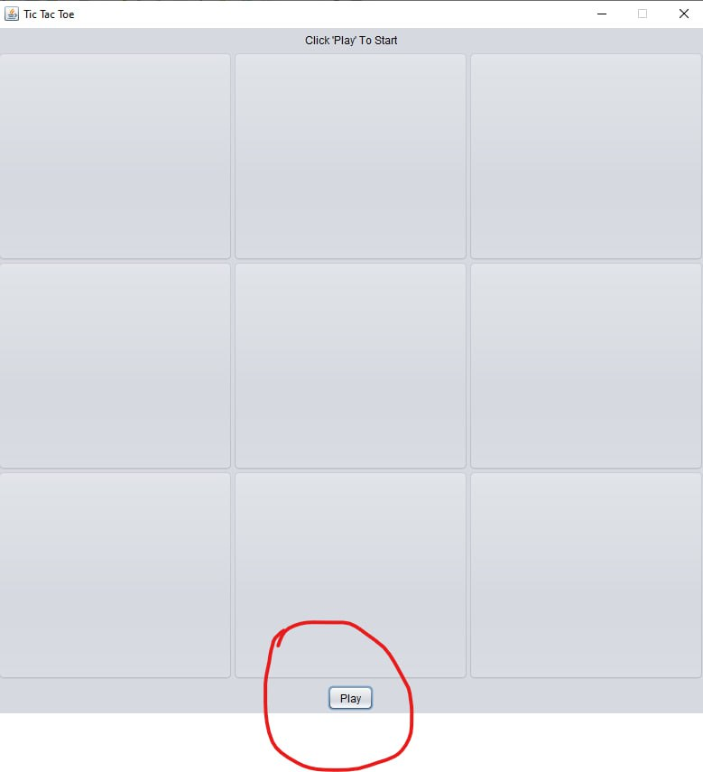
When you choose play with machine
To start the first we touch the button play

Slide 6
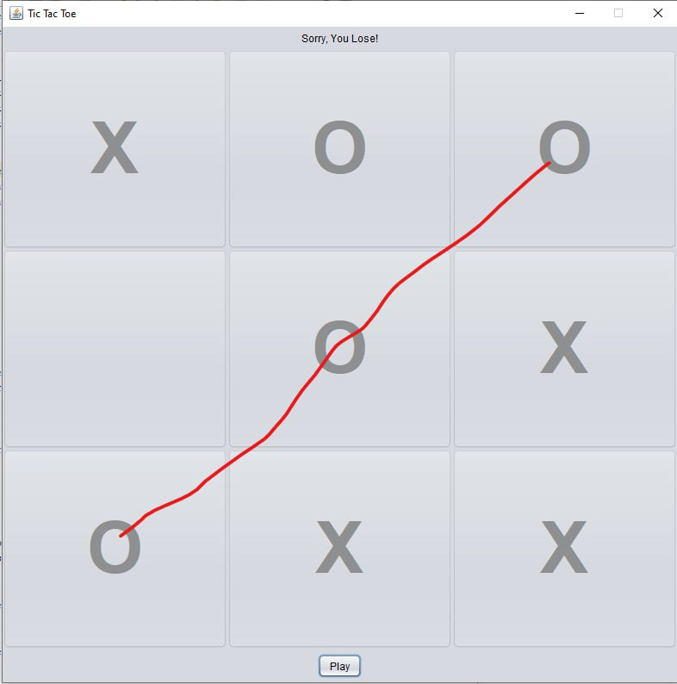
When player LOST the game by machine

Slide 7
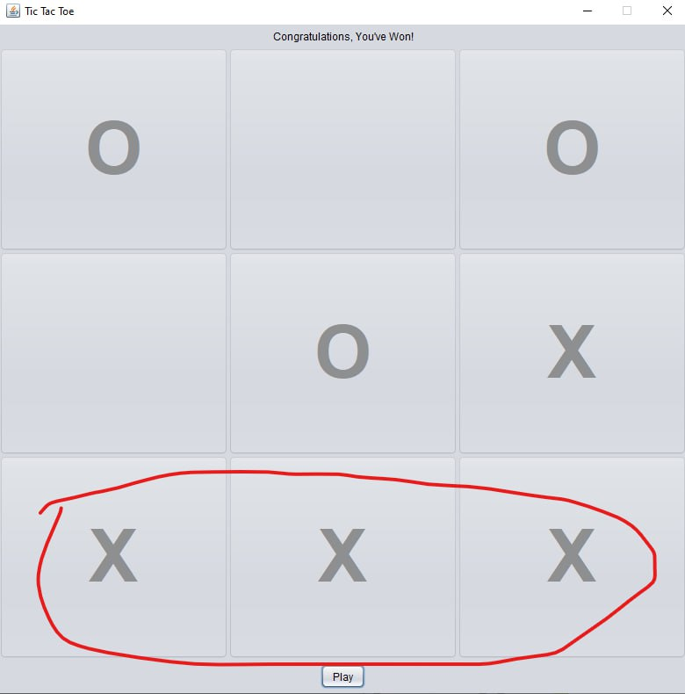
When player WIN the game with machine

Slide 8
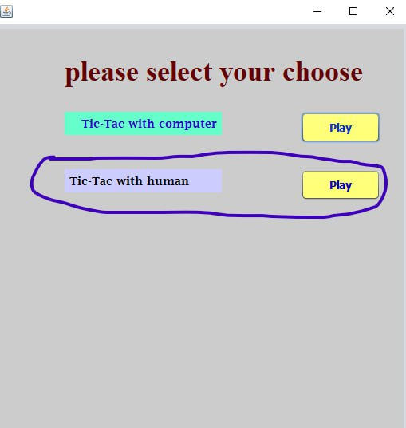
When you choose play with Human

Slide 9
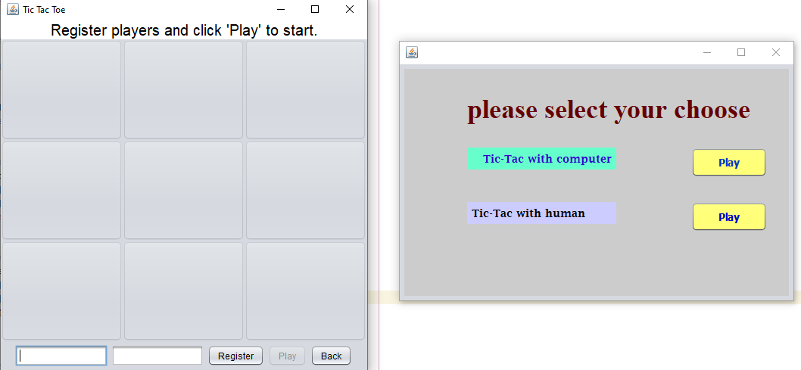
Players Register for starting the game

Slide 10
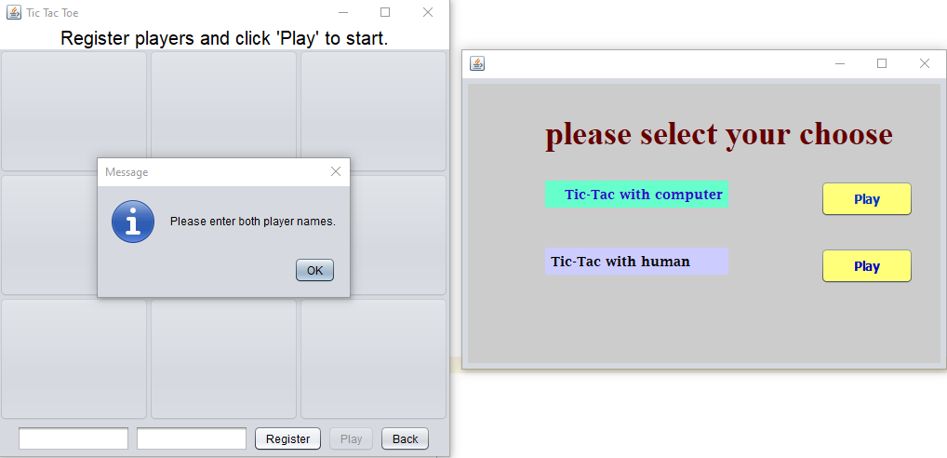
When players One and Two register their the name Hint: The players cannot play the game without register

Slide 11
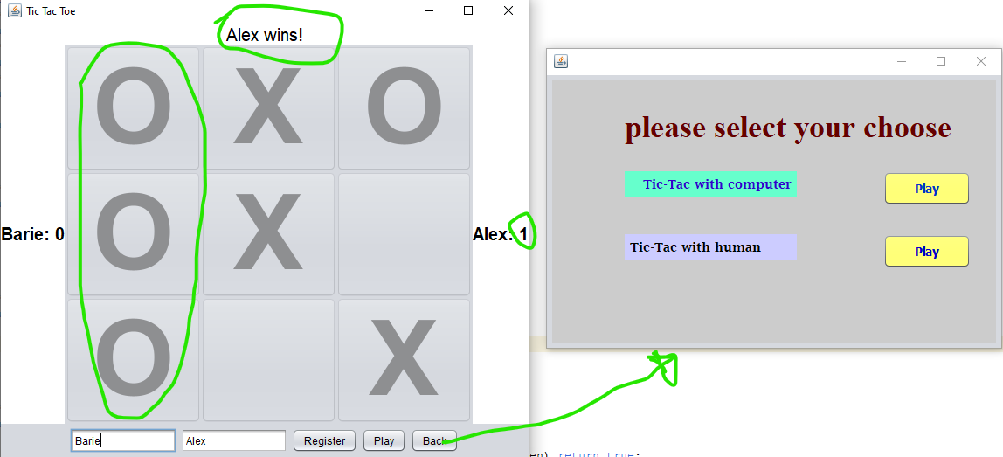
When players win the game

Slide 12
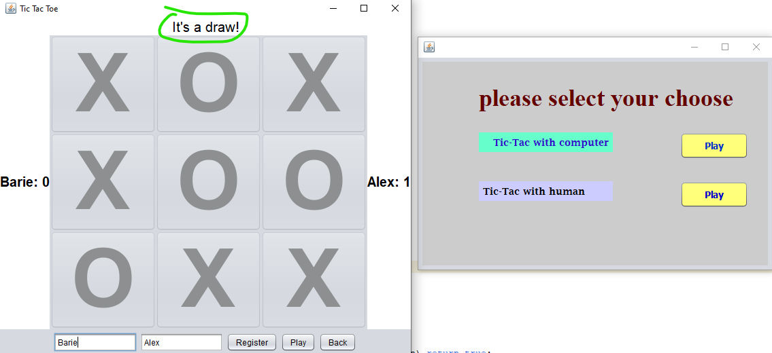
When The Game End With DRAWN

Slide 13
DESIGN PATTERN IN TIC TAC TOC GAME
Design patterns are reusable solutions to common problems in software design.
They provide best practices for structuring code and solving specific design challenges. While the modified code exhibits some level of organization and separation of concerns, it doesn't demonstrate the explicit implementation of a well-known design pattern.

Slide 14
CONT…
However, if you're looking to incorporate design patterns into Our Tic-Tac-Toe game, there are a few patterns that could be considered.
Model-View-Controller (MVC) Pattern:
The MVC pattern helps separate the application into three components: the model (data and logic), the view (user interface), and the controller (handles user input and updates the model and view).
This pattern can be useful for organizing the game logic and user interface interactions.

Slide 15
Cont…
The TicTacToe class can be considered the "model" component. It represents the internal state and logic of the tic-tac-toe game.
The Swing components (JFrame, JPanel, JButton, etc.) along with their event handlers (ActionListener) are part of the "view" component.
They are responsible for rendering the graphical user interface (GUI) and capturing user input.
The event handlers in the TicTacToe class, such as actionPerformed, handle user actions and update the model accordingly. They act as the "controller" component that coordinates the interactions between the model and the view.

Slide 16
Observer Pattern
Observer Pattern:
The observer pattern establishes a one-to-many relationship between objects, where changes in one object (the subject) are automatically propagated to other dependent objects (the observers).
This pattern can be applied to update the game board and UI components when a player makes a move.

Slide 17
Uses of Observer Pattern
In this code, the Observer pattern is used to implement the GameObserver interface and the addObserver, removeObserver, notifyObserversOnGameStart, and notifyObserversOnGameEnd methods in the TicTacToe class.
The GameObserver interface defines two methods: onGameStart and onGameEnd. These observers will be notified when the game starts or ends.
interface GameObserver {
void onGameStart();
void onGameEnd(String winner);
}

Slide 18
Objects that implement this interface can be registered as observers using the addObserver method.
public void addObserver( GameObserver observer) {
observers.add(observer);
}
Objects that implement this interface can be removed from observers using the removeObserver method.
public void removeObserver(GameObserver observer) {
observers.remove(observer);
}

Slide 19
CONT…
when the game ends, the notifyObserversOnGameEnd
private void notifyObserversOnGameEnd(String winner) {
for (GameObserver observer : observers) {
observer.onGameEnd(winner);
}
}
When the game starts, the notifyObserversOnGameStart method
private void notifyObserversOnGameStart() {
for (GameObserver observer : observers) {
observer.onGameStart();
}
}

Slide 20

Decorator pattern
The decorator pattern is a software design pattern that allows behavior to be added to an individual object, dynamically, without affecting the behavior of other objects from the same class.
In Tic Tac Toe, the Decorator pattern can be used to add additional features to the game, such as:
A scoring system: This would allow players to keep track of their wins, losses, and ties.

Slide 21
THANK YOU

